Slide 1

Watershed on entering short term market
October. 20, 2020

Slide 2
Story of airbnb
From an air mattress in living room to a $18 billion company

Slide 3
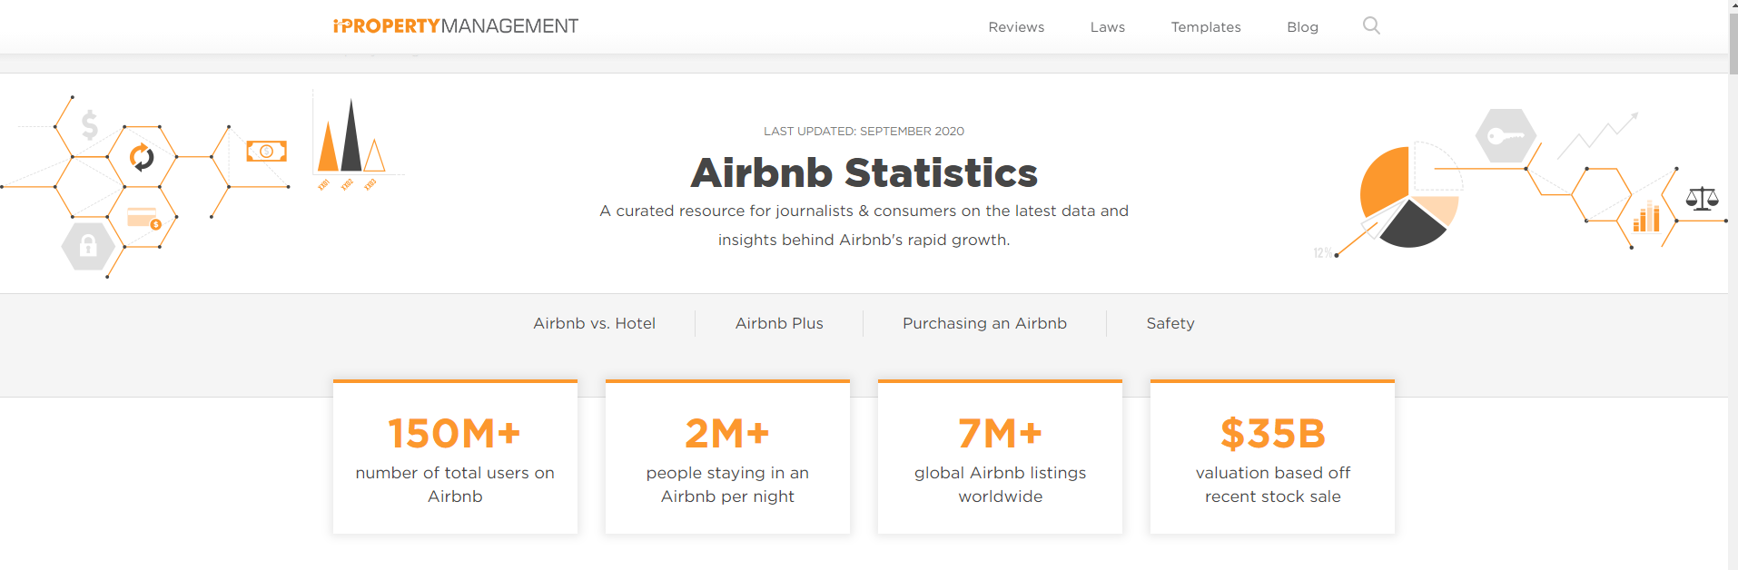
Airbnb statistics Last Updated: September 2020 (Source: ipropertymanagement)

Slide 4
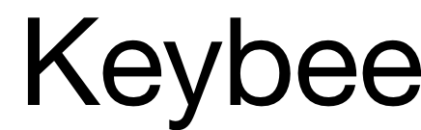



Many successful companies managing short-term rentals on Airbnb

Slide 5
Contents
1. Rationale for Recommendation
2. Baseline Recommendation
3. Implementation Methods
4. Forecasted Capital Expenditures
What I will cover in my presentation

Slide 6
Rationale
How I came up with my recommendation

Slide 7
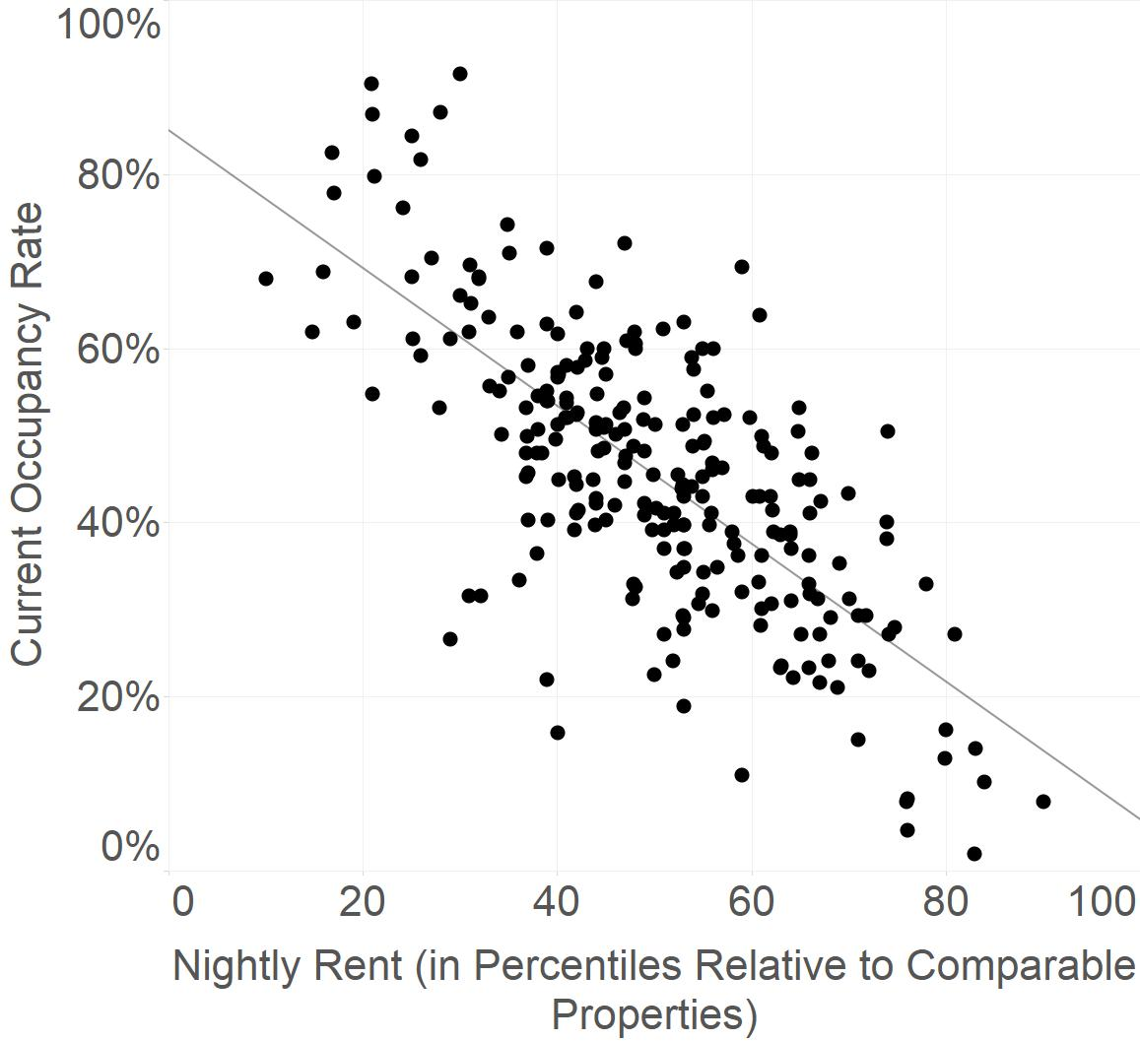
Find the rental price and occupancy rate that would maximize the profits expected from 244 Watershed’s clients’ properties.

Slide 8
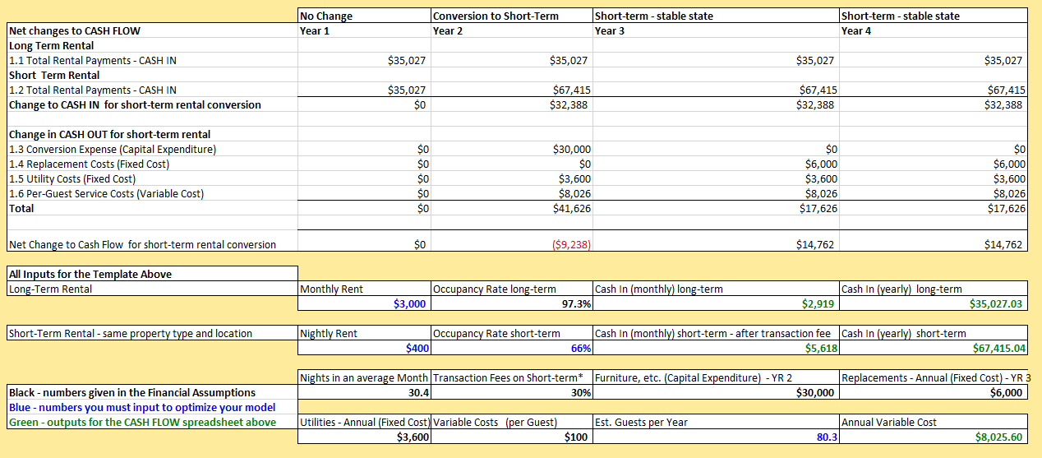
Find the rental price and occupancy rate that would maximize the profits expected from 244 Watershed’s clients’ properties.
Then, plug into a financial cash flow and profits model to compute the expected revenue from each property as well as the expected costs.

Slide 9
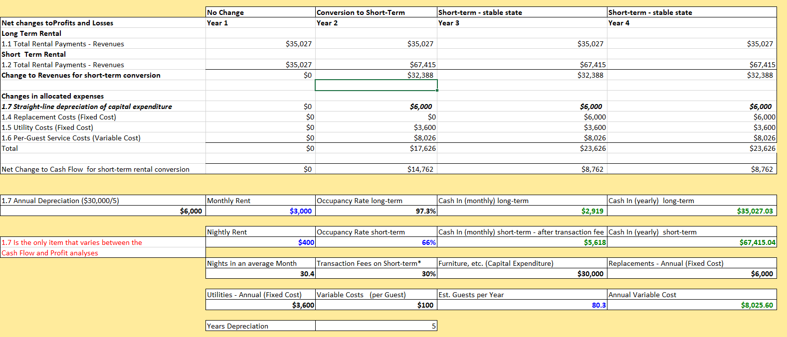
Find the rental price and occupancy rate that would maximize the profits expected from 244 Watershed’s clients’ properties.
Then, plug into a financial cash flow and profits model to compute the expected revenue from each property as well as the expected costs.

Slide 10
Recommendation
So, should Watershed enter the short-term market?

Slide 11
Yes!

Slide 12
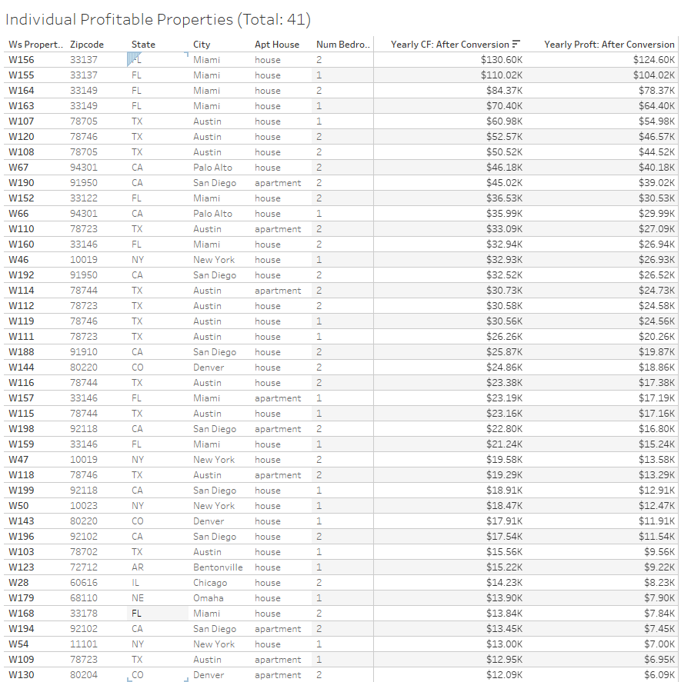
Watershed should take the opportunity to enter the short-term market with its clients
Highly profitable (>$6,000/year) properties in
Austin(TX)
San Diego(CA)
Miami(FL)
New York City(NY)
Maintain positive cashflow

Slide 13
Implementation
How should Watershed execute the transformation?

Slide 14
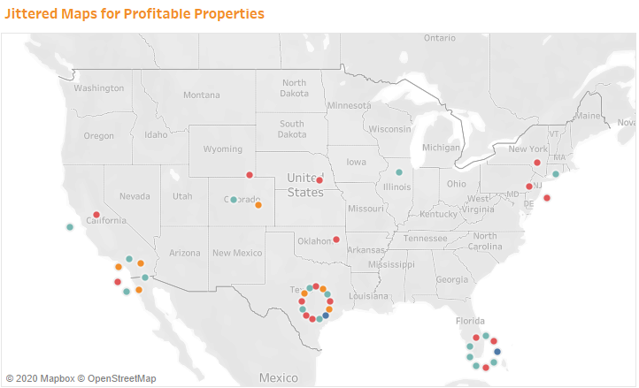
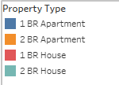
What properties should be focused on?

Slide 15
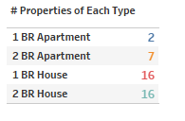
AMONG TOP 5 PROFITABLE PROPERTIES,
4 ARE IN MIAMI, FL.
➔We can consider converting other clients’ properties to short-term rentals in Miami
➔ Houses are much better for converting to short-term rentals

Slide 16
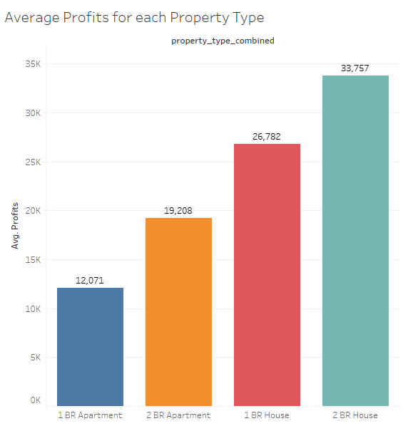
2 Bedroom House in Austin – TX or Miami – FL would be great choices to start with our conversion

Slide 17
When should they be converted?
Can be divided into several stages

Slide 18
OPTION 1:
Convert the rest properties
Yes
20 most profitable properties
Conversion Year
Is Model doing great?
Collect real data and modify the model
No
Less Risky
Go with other properties or return them to long-term

Slide 19
OPTION 2: Convert whole 41 properties
More Risky
But also, more $$$

Slide 20
Forecasted statistics
So, what is the outcome that Watershed can expect?

Slide 21
$1,230,000
Forecasted Expenditures
$390,000
Forecasted Cash Flow for Conversion Year
$1,370,000
Forecasted Cash Flow for the year after
This is based on the assumption that the average cost of converting one property is $30,000
$1,370,000
Forecasted Profits for Conversion Year
$1,110,000
Forecasted Profits for each year after

Slide 22
Sensitivity analysis
Is the model reliable under different circumstances?

Slide 23
How robust is the model?
MIN
MAX
When one or more input variables or assumptions (transaction fees, hospitality charges, average nights stay…) are drastically changed due to unforeseen circumstances, the model still provides us with relevant actions and insights.
I tested the model with different sets of values to see how the number varies
Maximum Profits: $4,300,000
Minimum Profits: $71,000, still greater than 0
Detailed in White Paper.

Slide 24
How variables affect the model?
Ceteris paribus,
1% Service Fees
1 year depreciation
$63K
$82K
1% Regulatory Fees
$1 Hospitality Charges
$54K
$3K
1 average night stay
$125K

Slide 25
SUMMARY
Watershed should enter the short-term rental markets with its clients’ properties
Great markets to start would be Austin-TX, Miami-FL, San Diego-CA, and NYC-NY
2 Stages with less risks

Slide 26
Thank you for your attention!

